Slide 1

ExtraTech Systems
Dig’nIT
Internship Program
Crista Falk

Slide 2
Company Overview

Slide 3
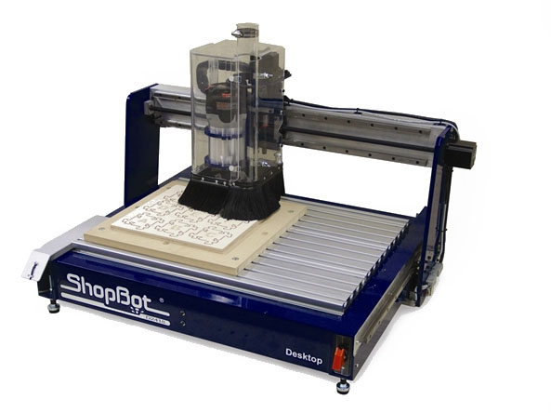

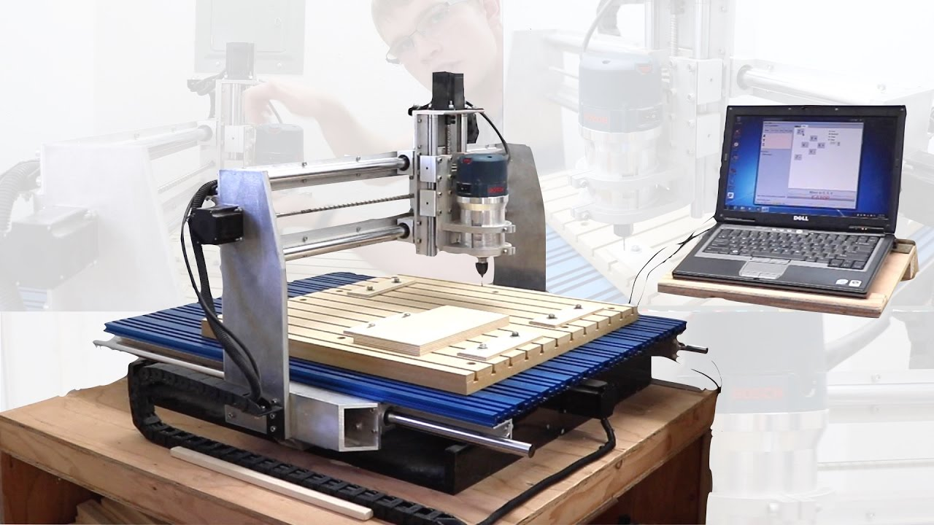
For over 25 years ExtraTech Systems has designed and manufactured motion control technology for thousands of CNC motion applications across North America and into Europe. Working exclusively with OEM's and high-volume users, our technology provides cost-effective, powerful and flexible solutions for motion automation.

Slide 4
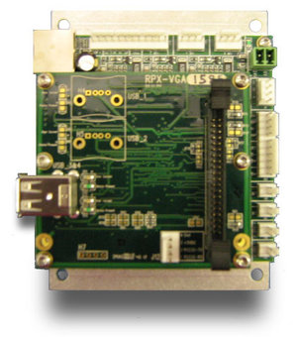
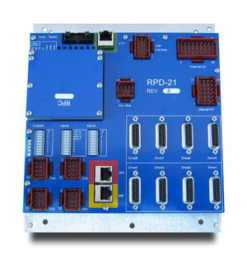
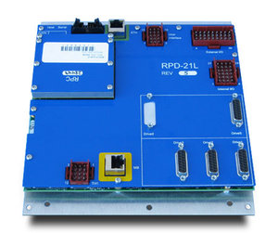
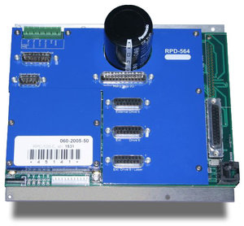
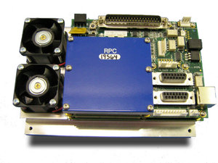
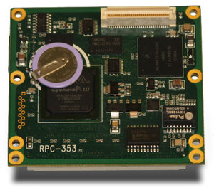
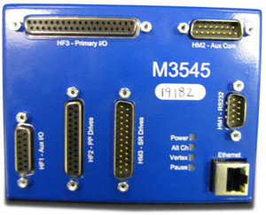
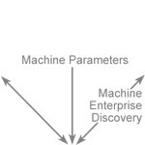
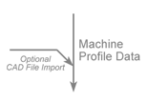
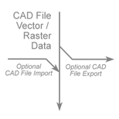
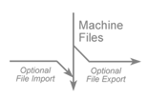
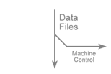
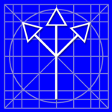

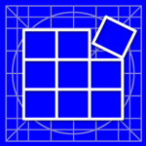


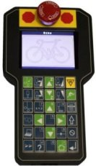
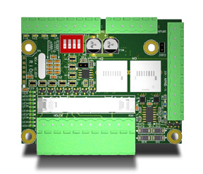
MOTION CONTROLLERS
SOFTWARE
PERIPHERALS
Intelligent, state-of-the-art, multi-function, multi-axis, programmable motion controllers and interface hardware are our specialty.
Depending on your application, we can support up to fourteen axis, use of steppers or servos, on-board amplifiers or remote-third party, inputs & outputs, network communications, and HMI interface.
Coreo CAD/CAM Software Suite. A complete platform or A-la-carte, Coreo includes CAD, Tool-Pathing, Tool Operation, and ancillary Utilities.
Utility software to configure your ExtraTech Motion Controllers, optimizing functionality to fully support your unique machine characteristics.
ExtraTech also designs and manufactures our own peripheral components, exclusively for use with ExtraTech Motion Controllers.
Primary products include:
A Robust Hand-Held Pendant
For Machine Monitoring & Control
Remote I/O Modules
For Distributed Machine Architectures

Slide 5

Coreo is an intuitive, well thought out CAD/CAM software experience. A suite for five individual modules, clarity and ease of use are platform cornerstones. Standardized parameters and terminology, intelligent libraries, user defined processes, and sophisticated processing techniques are all features that bolster Coreo’s exceptional functionality. With Coreo, work errors decrease and tempo quickens.

Slide 6

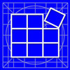

Serving as a single, common interface to start each Coreo module, Connect also allow the user to quickly connect with machine control systems located throughout the production area. Download control programs & parameters, launch other Coreo modules, and conveniently access status and diagnostic information useful for configuration or troubleshooting.
is a CAD-based creation environment. Start from scratch or import an existing file. Tools in this robust platform include scaling, sizing, fitting & alignment, and complete text tools, even 100+ engraver fonts. Graphic features include creating and editing shapes & objects, node editing for vectorized graphics, ability to import stroke widths (CMX, CMF, AI, and EPS), and a wide array of import/export filters.
applies parameters and tool paths to CAD drawings, converting them to machine-ready CAM files. Manage multiple jobs, tools, and processes. Use standard software parameters and industry terms to preview, execute, and control projects. Contextual display is friendly and intuitive. Intelligent shape and material process libraries, easy adjustments, auto tool paths, and advanced processing all support quick, efficient nesting & optimum sheet yield.
opens CAD / CAM files for execution on machine tools. It provides support for job queue, barcode, a smart shape library, job history, time estimation, simulation, and unlimited material and process support. Users can conveniently adopt, execute, and adjust parameters established in Design. Preview & step through jobs prior to execution. View real time job progress, and graphically restart within the job file.
allows the user to make informed assessment of business and machine performance thanks to an assortment of reports that summarize job and machine status, per job or over multiple machines and multiple shifts.
Sercommon interface to start each Coreo module. Connect also allow the user to quickly connect with machine control systems located throughout the production area. Download control programs & parameters, launch other Coreo modules, a n d .conveniently access status and diagnostic information useful for configuration or troubleshooting. .
CAD-based creation environment. Start from scratch or import an existing file. Tools in this robust pl atform include scaling, sizing, fitting & alignment, and complete text tools, even 100+ engraver fonts. Graphic features include creating and editing shapes & objects, node editing for vectorized graphics, ability to import stroke widths (CMX, CMF, AI, and EPS), and a wide array of import/export filters.
applies parameters and tool paths to CAD drawings, converting them to machine-ready CAM files. Manage multiple jobs, tools, and processes. Use standard software parameters and industry terms to preview, execute, and control projects. Contextual display is friendly and intuitive. Intelligent shape and material process libraries, easy adjustments, auto tool paths, and advanced processing all support quick, efficient nesting & optimum sheet yield.
opens CAD / CAM files for execution on machine tools. ulation, and unlimited matrial and process support. Users can conveniently adopt, execute, and adjust parameters established in Design. Preview & step through jobs prior to execution. View real time job progress, and graphically restart within the job file.
alloassortment of reports that summarize job and machine status. the the th e the the the the the the the the the the the the the the the the the the the .
Coreo Connect:
Coreo Design:
Coreo Build:
Coreo Command:
Coreo Report:

Slide 7
Skills Overview

Slide 8
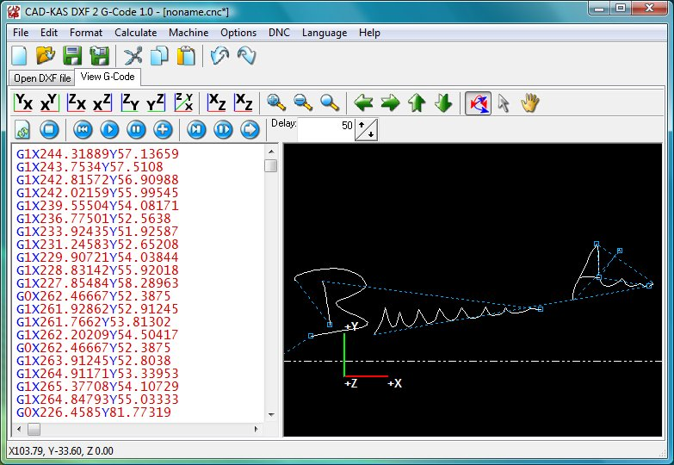
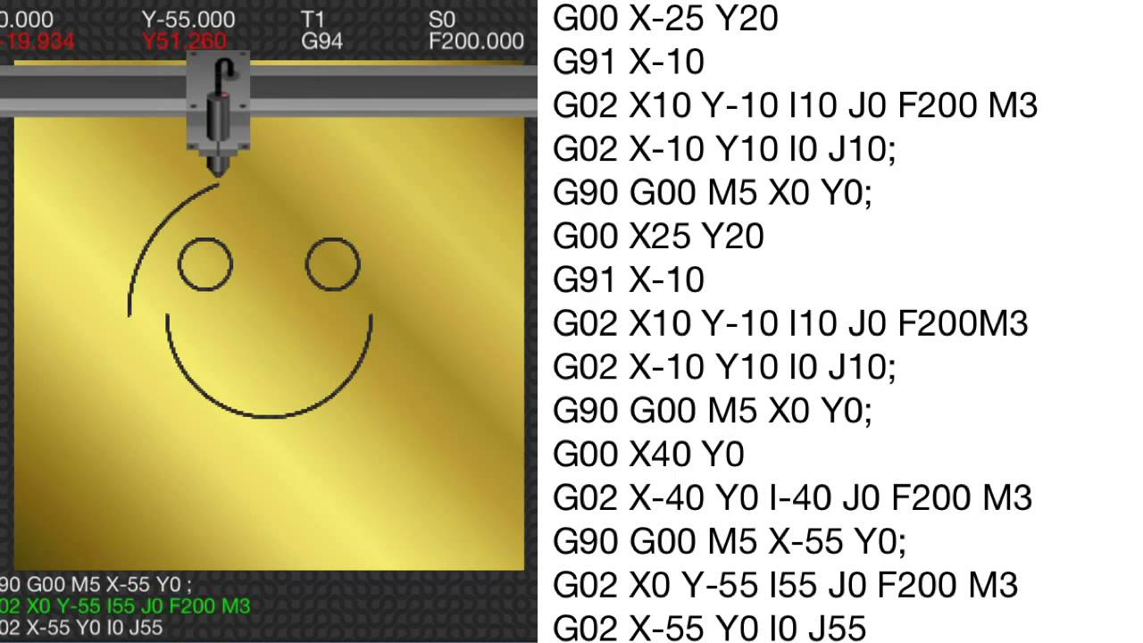
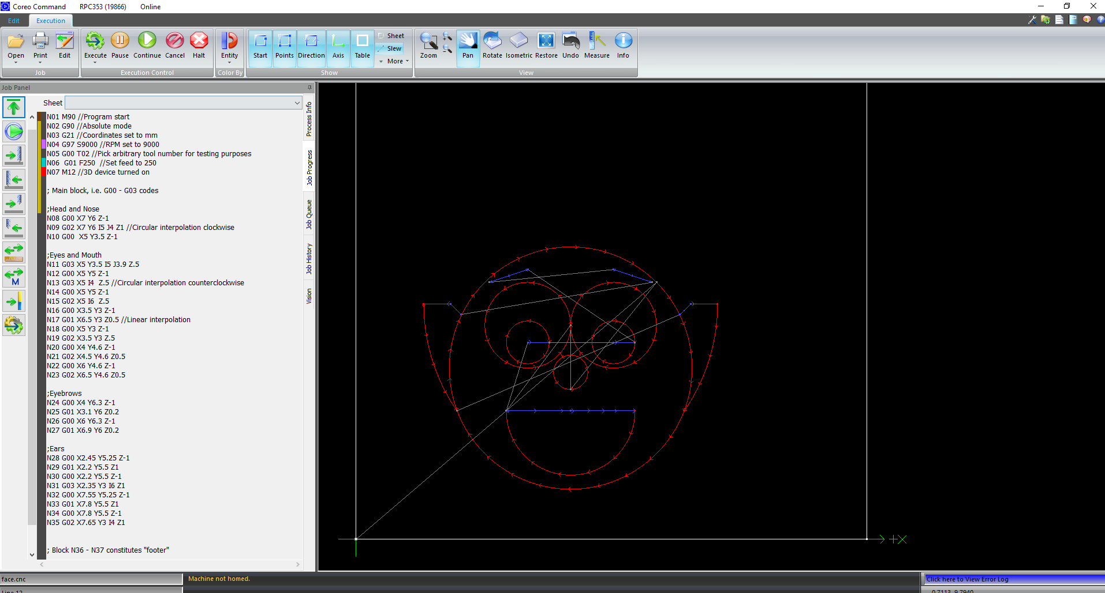
Computer Numerical Code (CNC)
“G”-Code

Slide 9

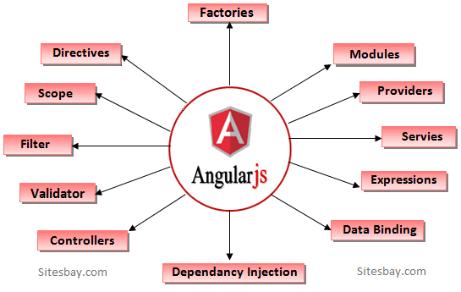
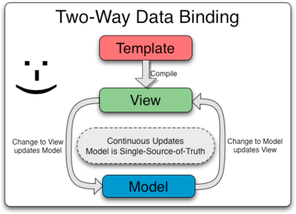
Model– View– Controller (MVC) Application Design Pattern
AngularJS

Slide 10
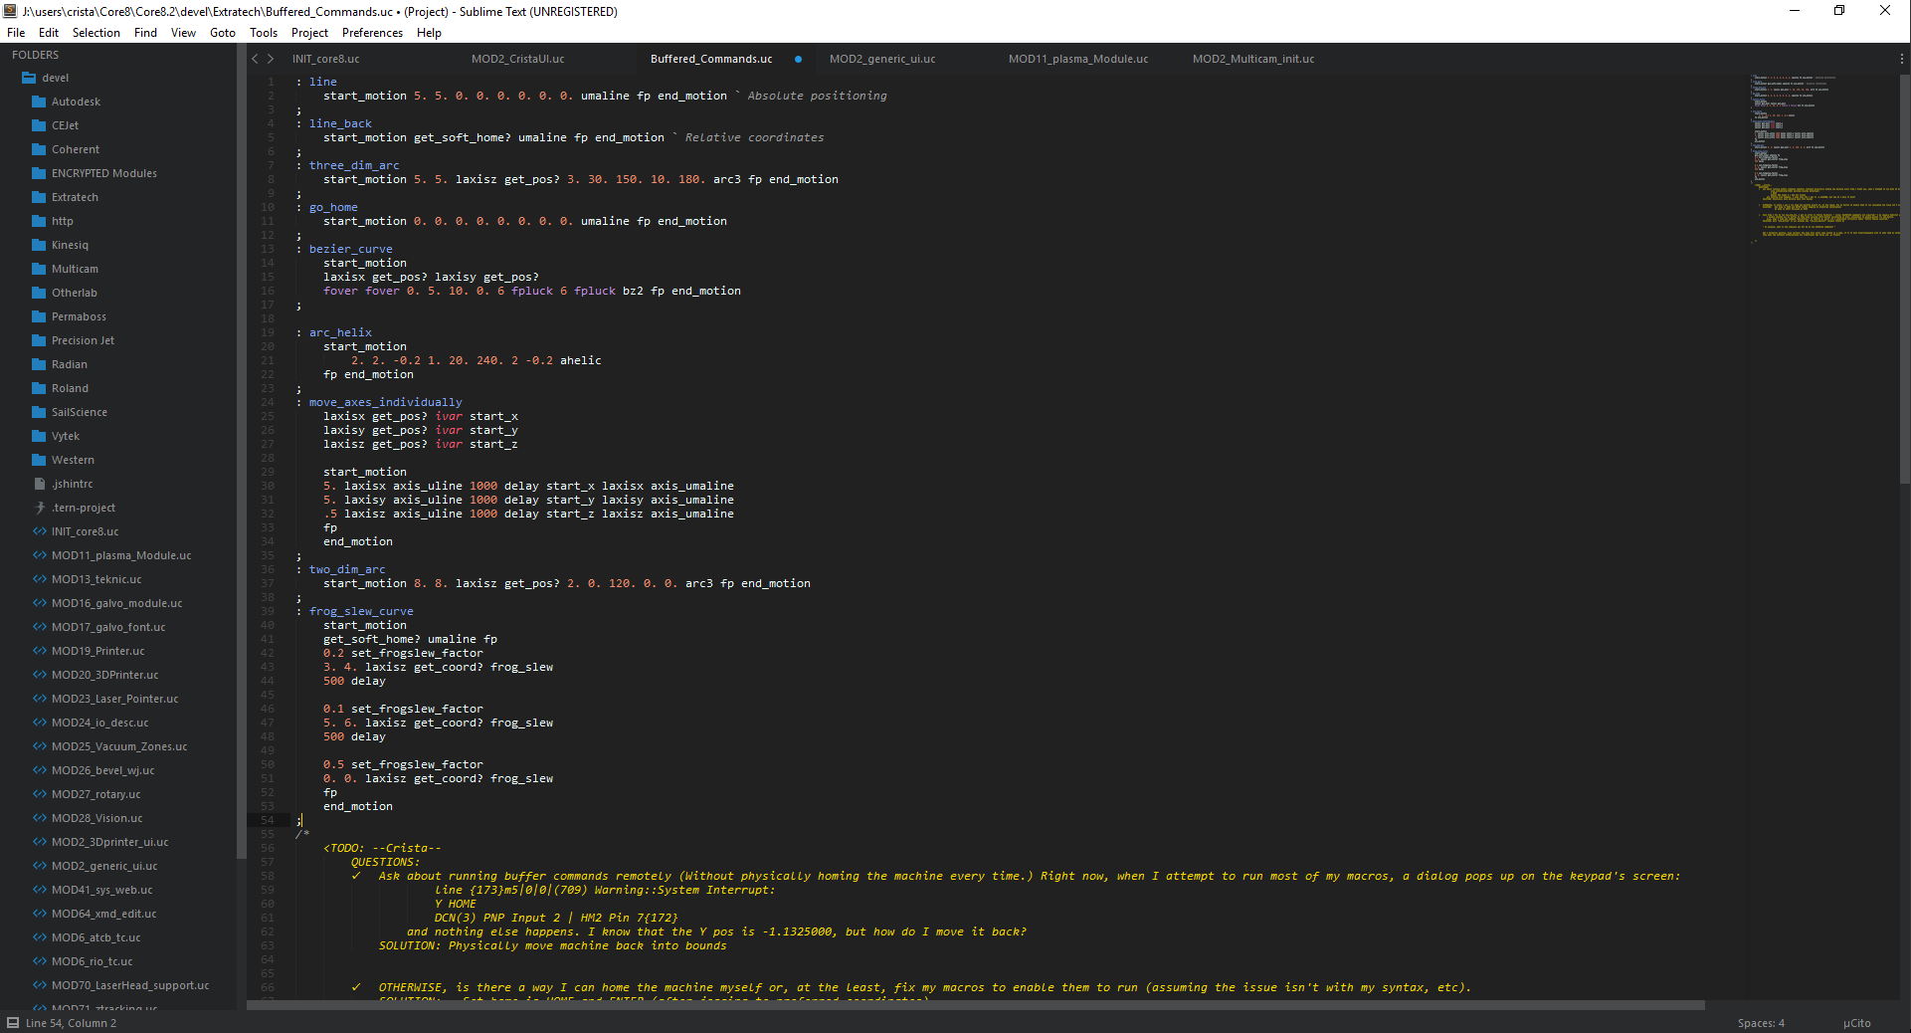
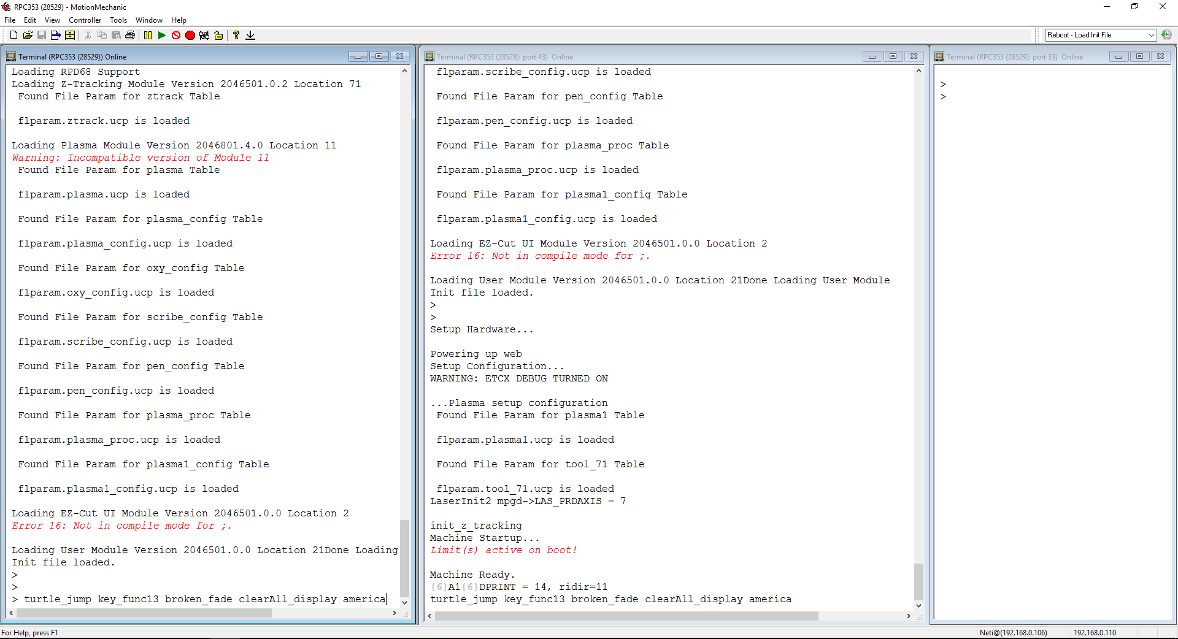
μCito
ExtraTech’s Proprietary Macro Language

Slide 11
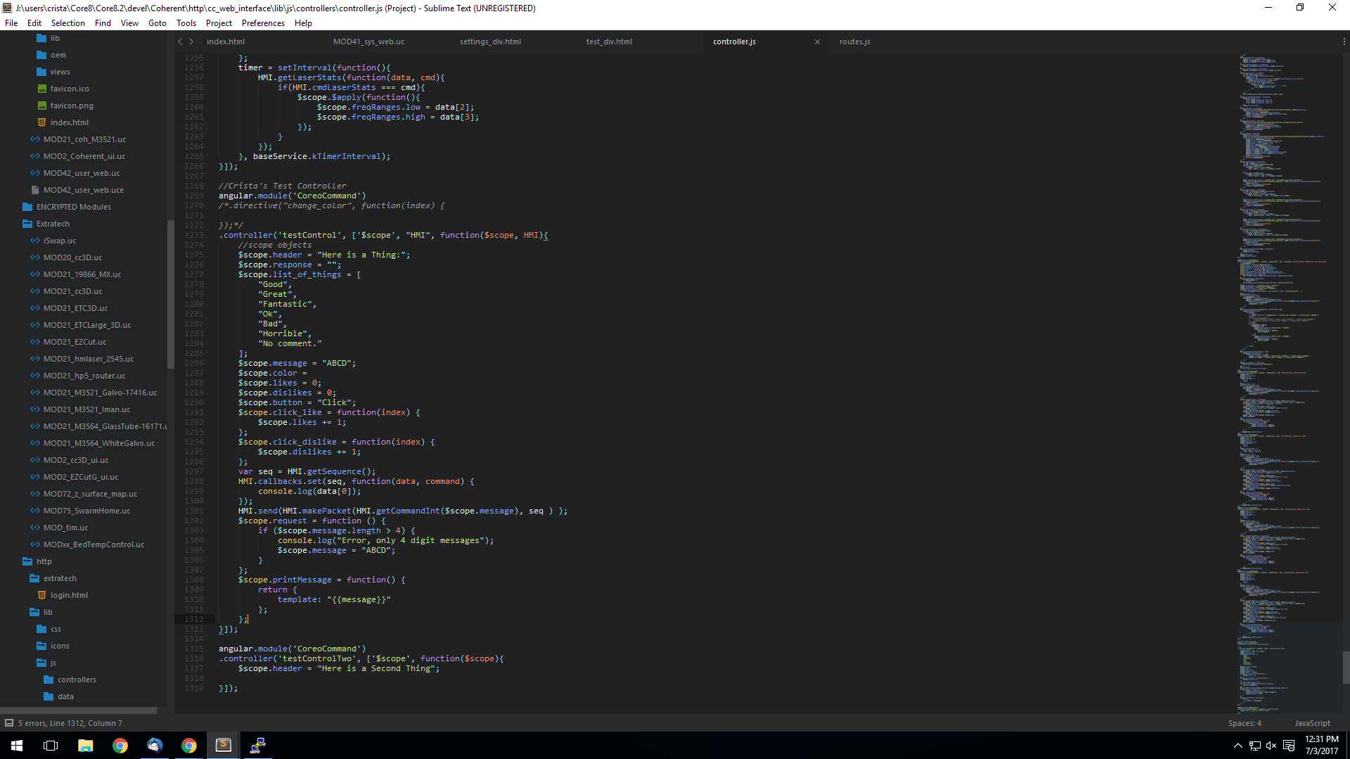
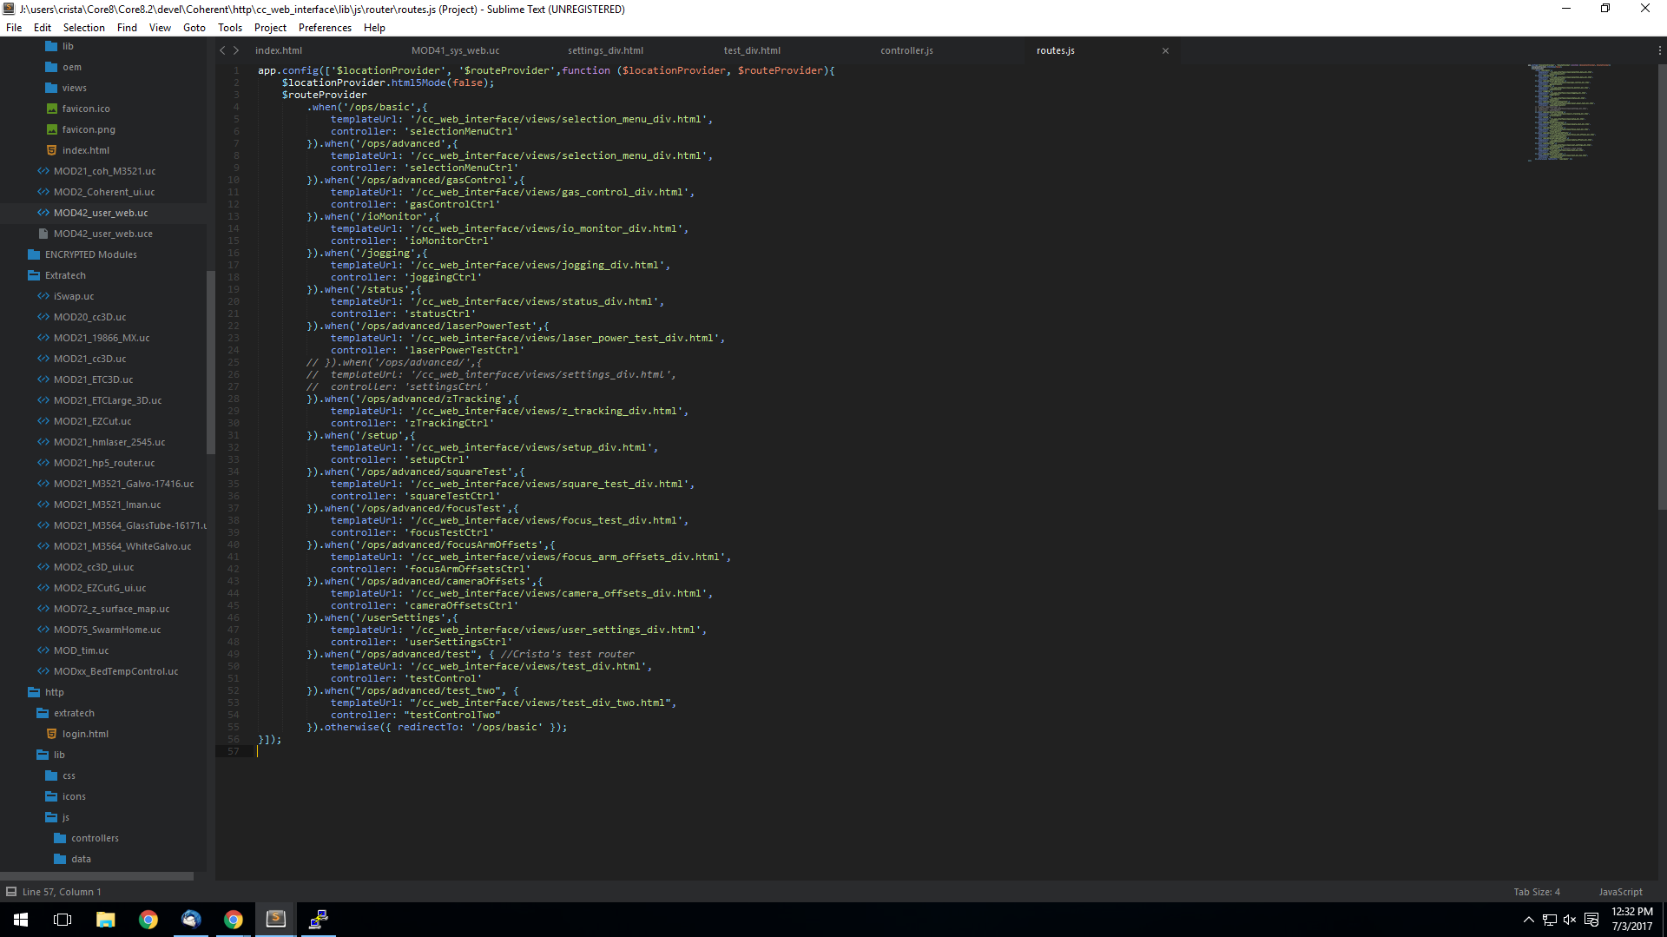
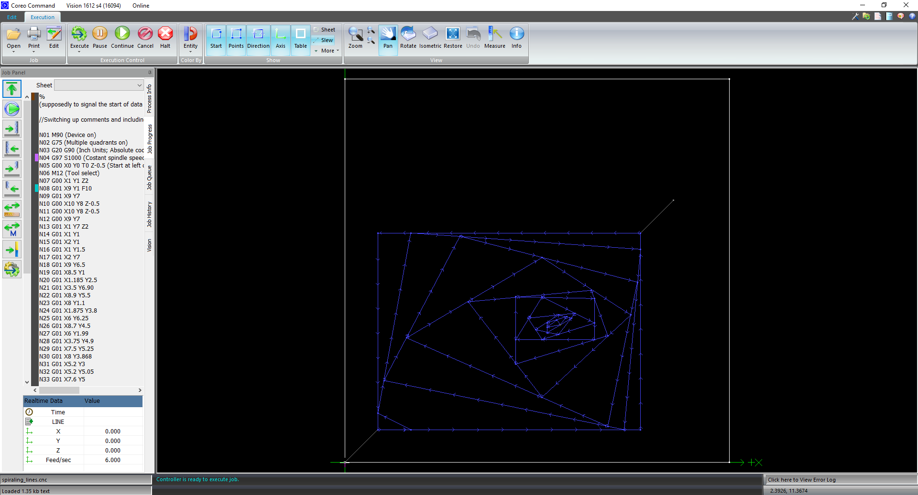
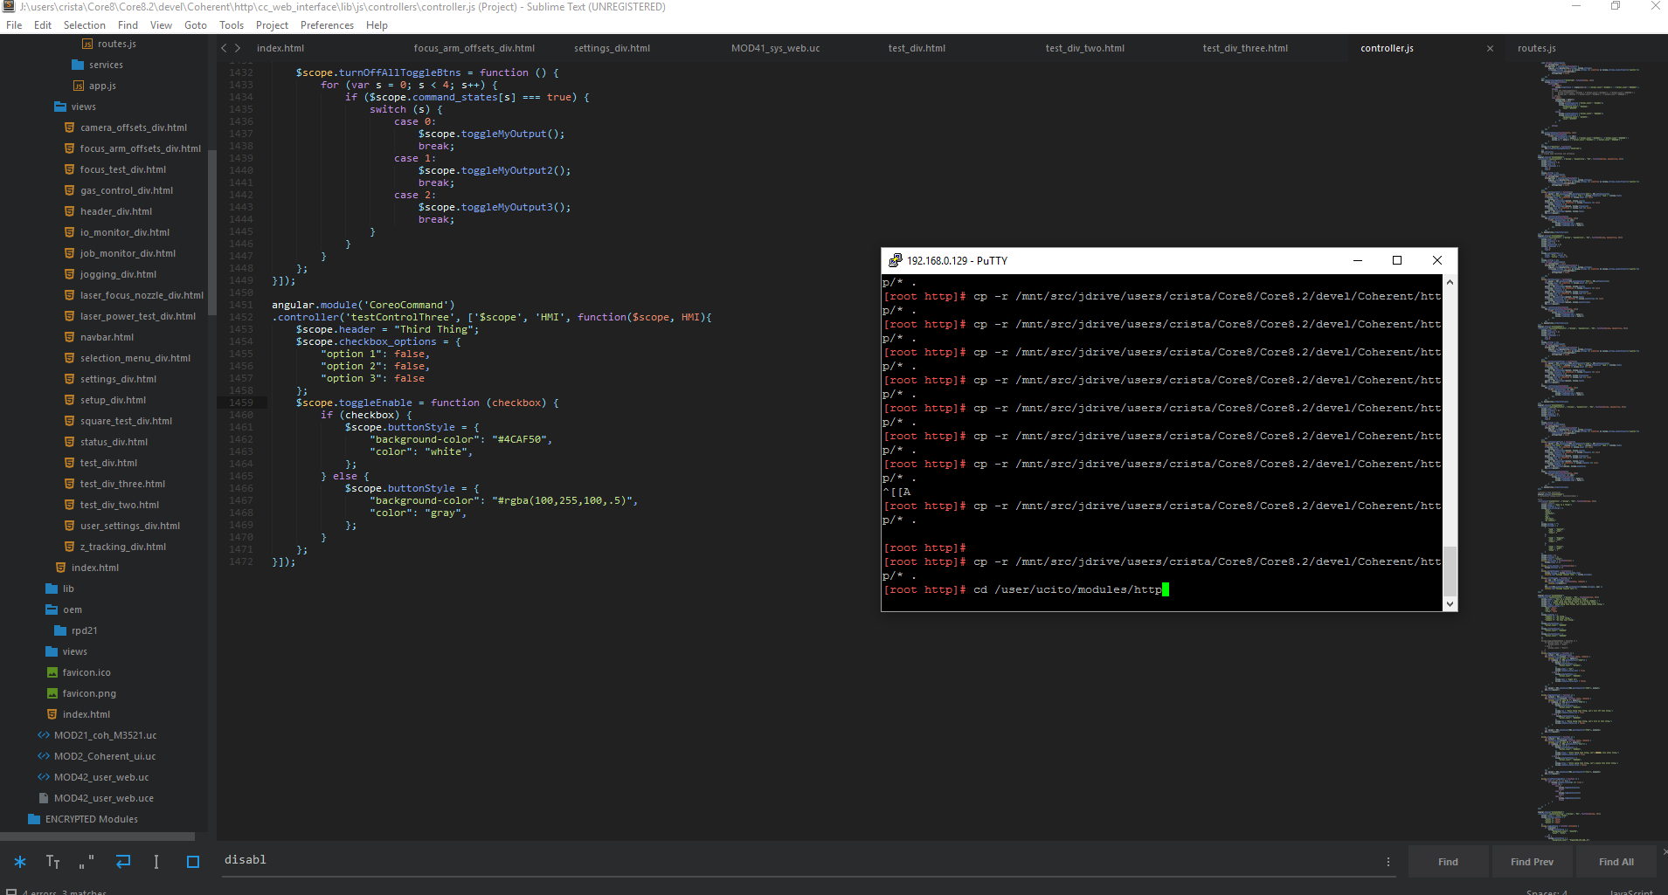
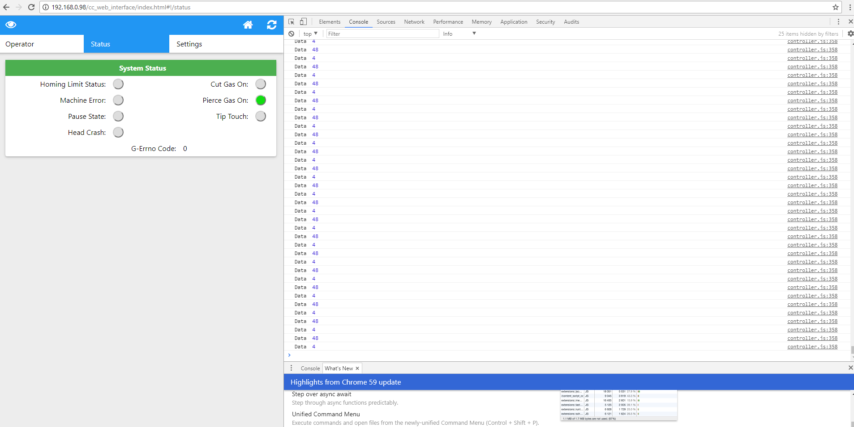

Slide 12
Projects Overview

Slide 13


Learning:
Coreo software suite
CNC (G-codes, M-codes)
μCito
AngularJS
CAM Processes
Cut, Engrave, Raster
Coreo Command HMI for Vytek
Modifying Extended Metadata (XMD) files
Using uCito to run motion commands
LCD interface of keypad controllers (my own; the Predator UI for Cincinnati)
Firmware Testing
Notes:
Pendants: -GLCD -cBOX support macro -Dialog support macro -widgets for grouping elements together

Slide 14
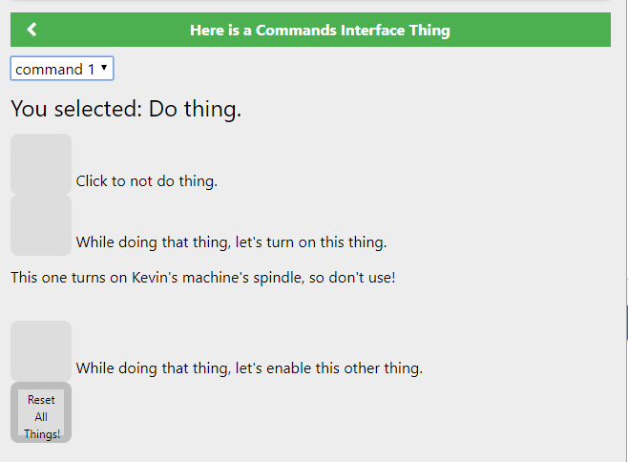
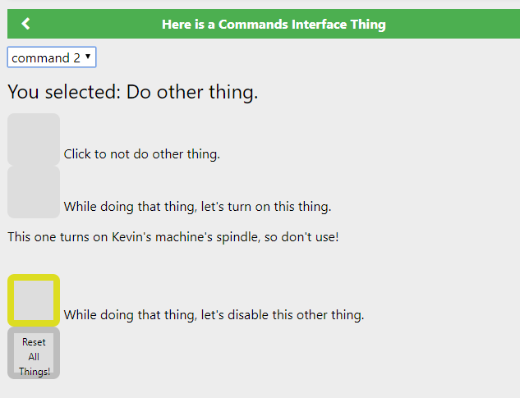
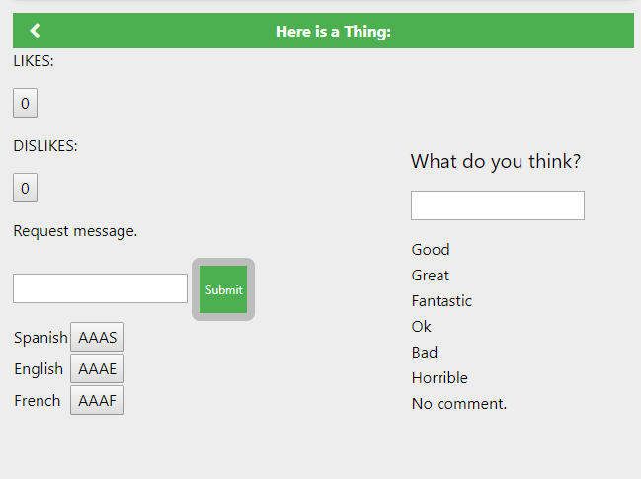
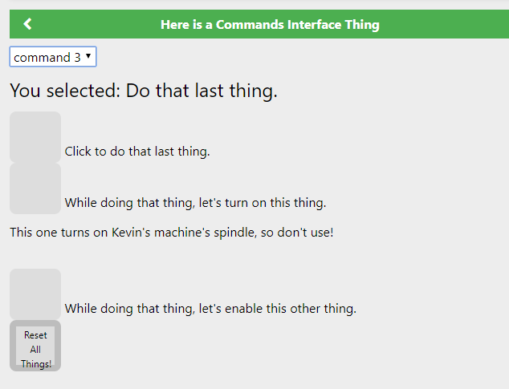
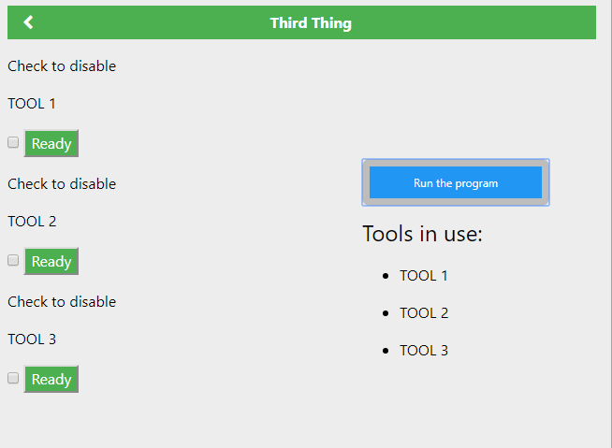
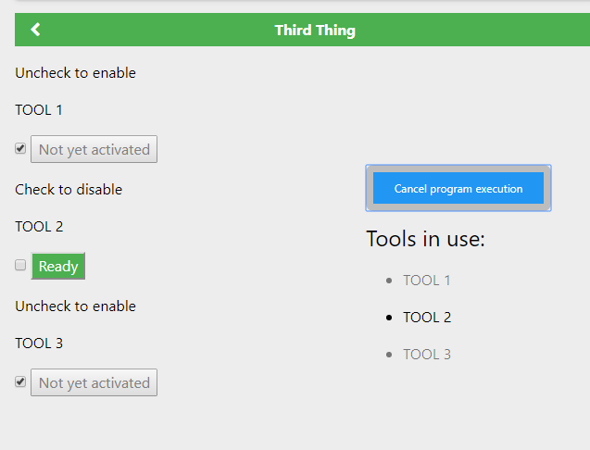
Creating Human Machine Interfaces (HMI)
Languages: uCito, HTML/CSS/JS
Device: CNC Machine

Slide 15
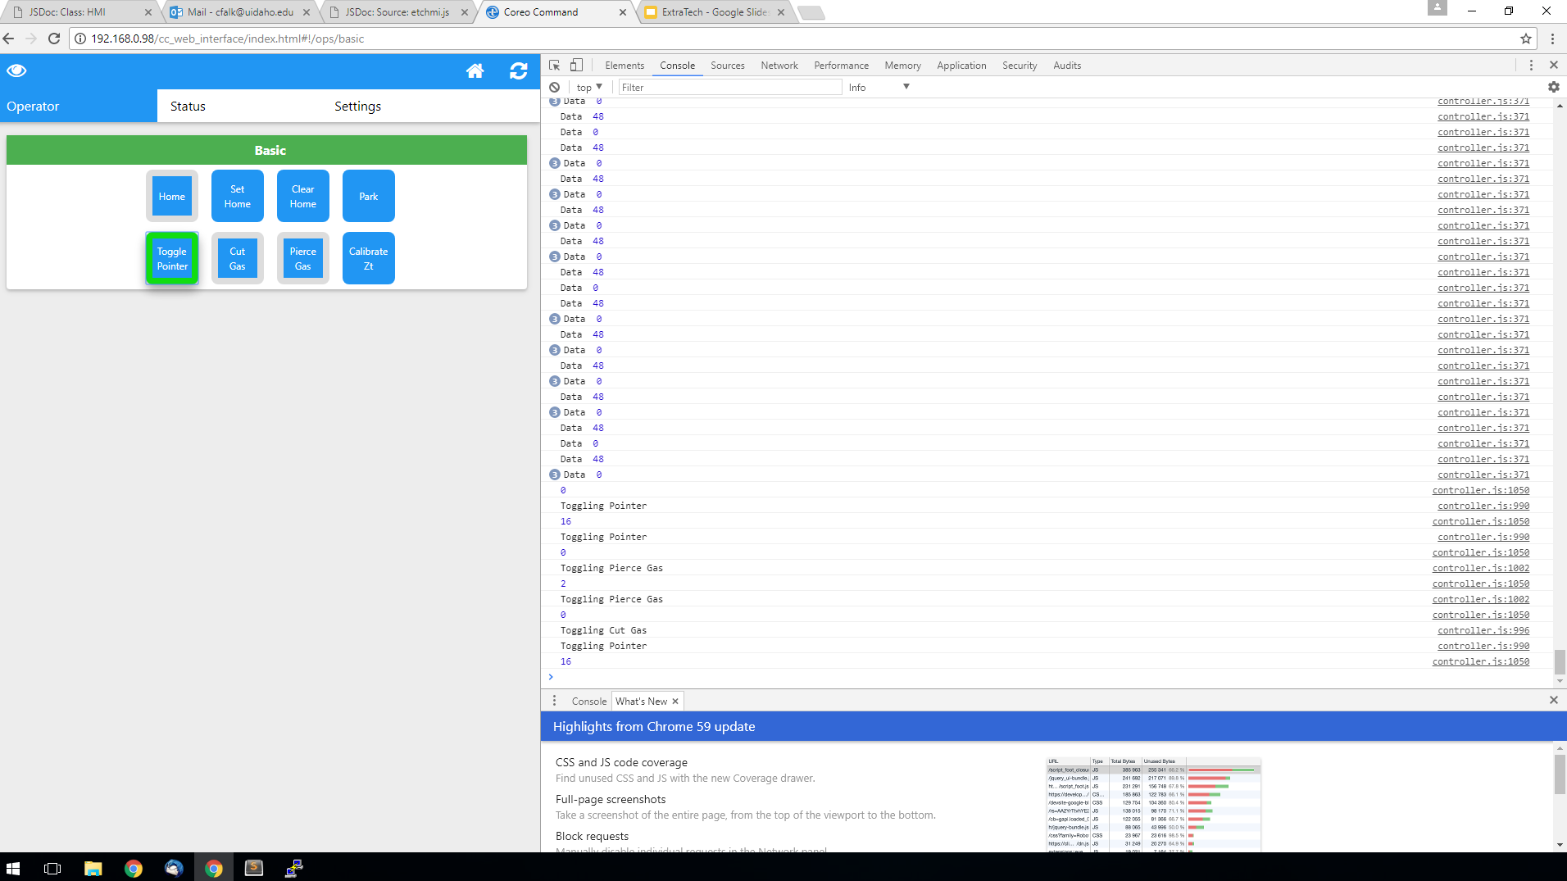
Coreo Command HMI for Vytek

Slide 16
Code Snippets

Slide 17
AngularJS (i.e. controller)
HMI
angular.module('CoreoCommand') .controller('statusCtrl', ['$scope', 'baseService', 'HMI', function ($scope, baseService, HMI){ $scope.strings = {}; void function getStrings(){ var stringsTimer = null; stringsTimer = setInterval(function() { angular.copy(baseService.strings, $scope.strings); if($scope.strings !== null && $scope.strings !== undefined && $scope.strings.hasOwnProperty('quality')){ clearInterval(stringsTimer); stringsTimer = null; } }); }(); $scope.gasPressure = 0; $scope.sysError = 0; var timer = null; $scope.gerrnum = 0; HMI.registerMessageHandler('STATUS', function(data, cmd){ var statusBtns = gebcn('statusButton'); switch(cmd){ case 2000:{ // CHS Head Crash if((data[0]&1<<4)){ statusBtns[0].css('background-color', '#11dd11'); }else{ statusBtns[0].css('background-color', '#dddddd'); } // Machine Error if((data[0]&1<<11)){ statusBtns[2].css('background-color', '#11dd11'); }else{ statusBtns[2].css('background-color', '#dddddd'); } // G-Errno Code if((data[0]&1<<7)){ statusBtns[4].css('background-color', '#11dd11'); }else{ statusBtns[4].css('background-color', '#dddddd'); } } break;
case 2001:{ // Cut Gas On if((data[0]&1<<2)){ statusBtns[1].css('background-color', '#11dd11'); }else{ statusBtns[1].css('background-color', '#dddddd'); } // Pierce Gas On if((data[0]&1<<1)){ statusBtns[3].css('background-color', '#11dd11'); }else{ statusBtns[3].css('background-color', '#dddddd'); } // Head Crash if((data[0]&1<<3)){ statusBtns[5].css('background-color', '#11dd11'); }else{ statusBtns[5].css('background-color', '#dddddd'); } // Tip Touch if((data[0]&1<<0)){ statusBtns[6].css('background-color', '#11dd11'); }else{ statusBtns[6].css('background-color', '#dddddd'); } } break; case 2002:{ if(data[0] !== null){ $scope.gerrnum = data[0]; } } break; } console.log("Data ", data[0]); }); HMI.refresh(); $scope.$on("$destroy", function(){ HMI.unregisterMessageHandler('STATUS'); clearInterval(timer); timer = null; }); }]);

Slide 18
AngularJS pt 2 (i.e. routing)
HMI
app.config(['$locationProvider', '$routeProvider',function ($locationProvider, $routeProvider){ $locationProvider.html5Mode(false); $routeProvider .when('/ops/basic',{ templateUrl: '/cc_web_interface/views/selection_menu_div.html', controller: 'selectionMenuCtrl' }).when('/ops/advanced',{ templateUrl: '/cc_web_interface/views/selection_menu_div.html', controller: 'selectionMenuCtrl' }).when('/ops/advanced/gasControl',{ templateUrl: '/cc_web_interface/views/gas_control_div.html', controller: 'gasControlCtrl' }).when('/ioMonitor',{ templateUrl: '/cc_web_interface/views/io_monitor_div.html', controller: 'ioMonitorCtrl' }).when('/jogging',{ templateUrl: '/cc_web_interface/views/jogging_div.html', controller: 'joggingCtrl' }).when('/status',{ templateUrl: '/cc_web_interface/views/status_div.html', controller: 'statusCtrl' }).when('/ops/advanced/laserPowerTest',{ templateUrl: '/cc_web_interface/views/laser_power_test_div.html', controller: 'laserPowerTestCtrl' // }).when('/ops/advanced/',{ // templateUrl: '/cc_web_interface/views/settings_div.html', // controller: 'settingsCtrl' }).when('/ops/advanced/zTracking',{ templateUrl: '/cc_web_interface/views/z_tracking_div.html', controller: 'zTrackingCtrl' }).when('/setup',{ templateUrl: '/cc_web_interface/views/setup_div.html', controller: 'setupCtrl' }).when('/ops/advanced/squareTest',{ templateUrl: '/cc_web_interface/views/square_test_div.html', controller: 'squareTestCtrl'
}).when('/ops/advanced/focusTest',{ templateUrl: '/cc_web_interface/views/focus_test_div.html', controller: 'focusTestCtrl' }).when('/ops/advanced/focusArmOffsets',{ templateUrl: '/cc_web_interface/views/focus_arm_offsets_div.html', controller: 'focusArmOffsetsCtrl' }).when('/ops/advanced/cameraOffsets',{ templateUrl: '/cc_web_interface/views/camera_offsets_div.html', controller: 'cameraOffsetsCtrl' }).when('/userSettings',{ templateUrl: '/cc_web_interface/views/user_settings_div.html', controller: 'userSettingsCtrl' }).otherwise({ redirectTo: '/ops/basic' }); }]);
The “Brains”

Slide 19
HTML (i.e. view)
HMI
<!-- Controller Status View --> <div ng-controller="statusCtrl" class="w3-animate-right" style="padding-bottom: 16px; padding-top: 16px;"> <!--<div ng-controller="statusCtrl" class="w3-animate-right">--> <div style="padding-bottom: 16px;"> <div class="w3-card-2 etc-theme-card"> <table class="w3-table w3-responsive"> <thead class="w3-green"> <th colspan="4" style="text-align:center;"><!-- System Status -->{{strings.system_status}}</th> </thead> <tr> <td style="float: right;"><!-- Homing Limit Status -->{{strings.homing_limit_status}}:</td><td><button style="float:left;" class="statusButton"></button></td> <td style="float: right;"><!-- Cut Gas On -->{{strings.cut_gas_on}}:</td><td><button style="float:left;" class="statusButton"></button></td> </tr> <tr> <td style="float: right;"><!-- Machine Error -->{{strings.machine_error}}:</td><td><button style="float:left;" class="statusButton"></button></td> <td style="float: right;"><!-- Pierce Gas On -->{{strings.pierce_gas_on}}:</td><td><button style="float:left;" class="statusButton"></button></td> </tr> <tr> <td style="float: right;"><!-- Pause State -->{{strings.pause_state}}:</td><td><button style="float:left;" class="statusButton"></button></td> <td style="float: right;"><!-- Tip Touch -->{{strings.tip_touch}}:</td><td><button style="float:left;" class="statusButton"></button></td> </tr> <tr> <td style="float: right;"><!-- Head Crash -->{{strings.head_crash}}:</td><td><button style="float:left;" class="statusButton"></button></td> </tr> <tr> <td></td><td style="float: right"><!-- G-Errno Code-->{{strings.g_errno_code}}:</td><td><label >{{gerrnum}}</label></td> </tr> </table> </div> </div> </div>
The “Body”

Slide 20
μCito (i.e. communication & control of machines)
HMI
: hmi_GGER G_ERRNO HMI_PARAM_INT mover hmi_put_param hmi_send ; : hmi_SVFO drop ifexists u_set_vision_focus_offset "" u_set_vision_focus_offset\n" hmi_23exec ; ` Toggle Laser Pointer : hmi_TLPT drop "" u_pointer_toggle" macro_exec ; ` Toggle CutGas : hmi_TCUT drop "" u_cutgas_toggle" macro_exec ; ` Toggle Pierce Gas : hmi_TPCE drop "" u_pcegas_toggle" macro_exec ; 0 ivar STA0_REGISTER ` common system status ` b 0 = estop ` b 1 = sw stop ` b 2 = drive fault ` b 3 = machine fault ` b 4 = hw limit ` b 5 = overtemp ` b 6 = hw pause ` b 7 = paused ` b 8 = not homed ` b 9 = motors disabled ` b10 = controller in motion ` b11 = machine error 0 ivar DEV0_REGISTER ` user system status ` b 0 = chs tip touch ` b 1 = Purge gas on ` b 2 = cut gas on ` b 3 = head crash ` b 4 = laser pointer on
: u_goto_home "" Goto home request" 1 debugMsg 0 motion_active? if :exit endif ` this covers both normal and pause motion EXECUTING? if :exit endif MACHINE_FAULT dup 2 <> land if :exit endif MACHINE_FAULT 2 = if find_limits else mon? not if mon mon? not if :exit endif endif goto_softhome0 endif ; : u_set_home "" Set home request" 1 debugMsg 0 motion_active? if :exit endif EXECUTING? if :exit endif MACHINE_FAULT if :exit endif chk_paused? if :exit endif set_softhome0 ; : u_clr_home "" Clear home request" 1 debugMsg 0 motion_active? if :exit endif EXECUTING? if :exit endif MACHINE_FAULT if :exit endif chk_paused? if :exit endif #clr_home ;
: u_park "" Park request" 1 debugMsg 0 motion_active? if :exit endif EXECUTING? if :exit endif MACHINE_FAULT if :exit endif xchk if :exit endif mon? not if mon mon? not if :exit endif endif start_motion slew_mode CORE.PARK_OPTIONS program_park ` force xy park end_motion ; : u_pointer_toggle "" Toggle Pointer request" 1 debugMsg EXECUTING? if :exit endif laser_pointer_on? if laser_pointer_off else laser_pointer_on endif ; : u_cutgas_toggle "" Toggle CutGas request" 1 debugMsg CutGas? if CutGas_pff else CutGas_pn endif ; : u_pcegas_toggle "" Toggle PceGas request" 1 debugMsg PceGas? if PceGas_pff else PceGas_pn endif ; #TRACE_RESUME
The “Nervous System”

Slide 21
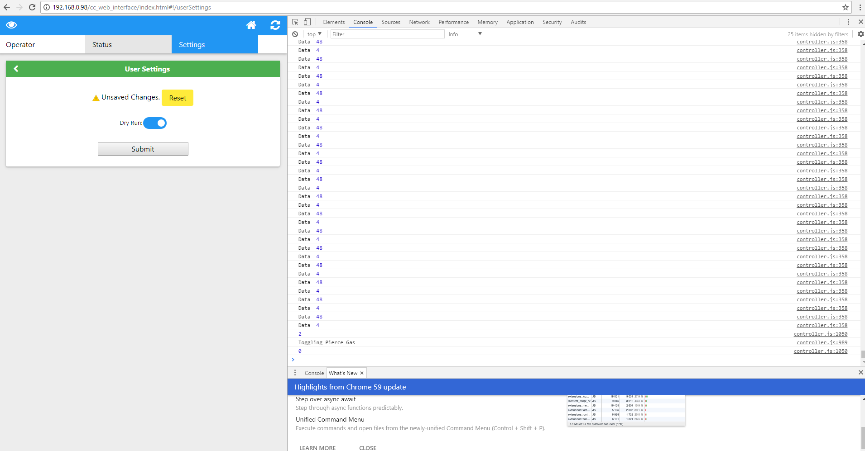
HMI
The Final Product

Slide 22
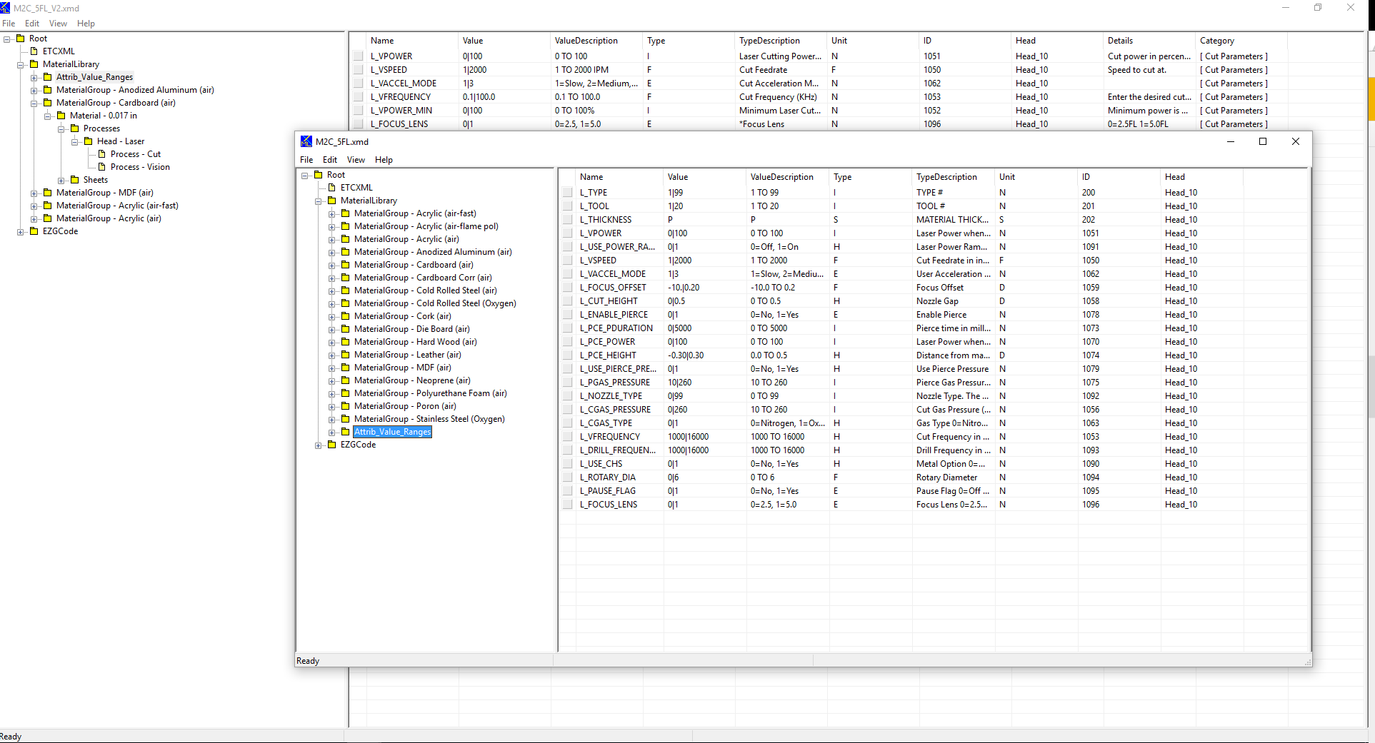
Modifying XMD files

Slide 23
Code Snippet

Slide 24
XMD Files (i.e. Materials Library, Processes Info)
XMD
<ETCXML version="2" SavedBy="C:\\Program Files (x86)\\Coreo Suite for ExtraTech\\ETCXMLUI.exe" Time="7/12/2017 11:34:51" NodeCount="265" /> <ETC_Document Name="MaterialLibrary" g_ZAlias="Cut Through=100%" g_ScribeFeed="-1" g_KnifePref="0" g_JC_Toolpath_CAD_Files="0"> <MaterialGroup Name="Acrylic (air-fast)"> <Material Name="0.125 (1/8) in" g_Thickness="0.125" g_Fudge="0" g_Flags="0" g_MaterialCutOut="0" g_TrackRemnant="0" g_RemnantX="0" g_RemnantY="0" g_RemnantCutTool="" g_DisableNest="0" g_MovePartsToOrigin="0" g_RandomNest="1" g_GroupNest="0" g_ArrayNest="0" g_ChainCut="0" g_CanMoveStartPoint="0" g_CommonLineCut="0" g_CmnLinePairOnly="0" g_NestToDefaultSheet="1" g_Clearence="0" g_RotationStep="180" g_CanFlip="0" g_MaxTilt="0" g_NestResolution="0.44" g_XSpanPenalty="400" g_YSpanPenalty="100" g_AutoNestFillDirection="1" g_DegradedAreaSeverity="0" g_SheetPriorityFactor="100" g_StartPointFactor="800" g_StartPointParam="0" g_ProcessOrder="0" g_PocketType="0" g_PocketOverlap="0" g_PocketConnectionLen="0" g_ThresholdArea="100" g_Tab="0" g_TriangularTab="0" g_TabMaxDist="0" g_TabMinDist="0" g_TabCount="4" g_TabHeight="0.2" g_TabWidth="0.2" g_TabClearance="0" g_DoOnionSkin="0" g_OnionSkinThickness="0" g_OninSkinOnlyOuter="0" g_OninSkinOnlySmallParts="0" g_DrainZMin="0" g_DrainZMax="0" g_CmnLineMinLen="0" g_ChainWidth="0" g_ChainMaxLen="0" g_ZAlias=""> <Processes> <Head Name="Laser"> <Process Name="Cut" g_ToolType="1052672" g_Flags="0" g_Diameter="0.01" g_Slot="61" g_Dwell="0" g_Power="0" g_IsMiscTool="0" g_IsMarker="1" g_Raster="0" g_LeadIn="0" g_LeadInParam="0.05" g_LeadInParam2="90" g_LeadOut="0" g_LeadOutParam="0.02" g_LeadOutParam2="90" g_XYFeedFullLoad="0" g_RollCorners="1" g_StartOnCorner="0" g_StartOnLongEdge="0" g_StartStraight="1" g_LeadOutOnlyOuter="0" g_StopShort="0" g_StopShortOnlyExterior="0" g_StopShortLen="0.02" g_TorchSuspend="0" g_TorchSuspendLen="0" MarkerGroup="" L_VPOWER="50" L_VSPEED="30" L_VACCEL_MODE="2" L_VFREQUENCY="8" L_VPOWER_MIN="10" L_CUT_HEIGHT=".020" L_FOCUS_LENS="1=5.0" L_FOCUS_OFFSET="0.000" L_LIFT_HEIGHT=".125" L_USE_CHS="0" L_USE_POWER_RAMPING="0" L_CGAS_TYPE="0" L_CGAS_DELAY="0" L_CGAS_PRESSURE="15" L_ENABLE_PIERCE="0" L_PCE_POWER="0" L_PCE_FREQ="5" L_PCE_PDURATION="0" L_PCE_HEIGHT="0.000" L_PGAS_DELAY="0" L_PGAS_PRESSURE="0" L_ROTARY_DIA="6.0" L_PAUSE_FLAG="0" L_DRILL_FREQUENCY="8" L_NOZZLE_TYPE="6" g_ToolNumber="61" e_PDTime="0" e_PUTime="0" e_CostPerPD="0" e_CostPerMinute="0" /> <Process Name="Vision" g_ToolType="5246976" g_Flags="0" g_Diameter="0" g_Slot="99" g_Dwell="0" g_Power="0" g_IsMiscTool="1" g_IsMarker="0" g_Raster="0" g_LeadIn="0" g_LeadInParam="0" g_LeadInParam2="0" g_LeadOut="0" g_LeadOutParam="0" g_LeadOutParam2="0" g_XYFeedFullLoad="0" g_RollCorners="0" g_StartOnCorner="0" g_StartOnLongEdge="0" g_StartStraight="0" g_LeadOutOnlyOuter="0" g_StopShort="0" g_StopShortOnlyExterior="0" g_StopShortLen="0" g_TorchSuspend="0" g_TorchSuspendLen="0" MarkerGroup="" /> </Head> </Processes> <Sheets> <Sheet Name="_DefaultSheet" g_Width="48" g_Height="48" g_Inventory="-1" g_EdgeClearance="0" g_Priority="50" g_Flags="0" g_Cost="0" g_LoadTime="0" g_Flags_Ex="0" g_Param1="0" g_Param2="0" /> </Sheets> </Material> </MaterialGroup> <Attrib_Value_Ranges> <Attrib_Value_Range Name="g_Diameter" Value="0|0.05" ValueDescription="0 TO 0.05" Type="F" TypeDescription="*Laser Spot Size" Unit="F" ID="601" Head="Head_10" Details="Spot size of laser." Category="CAD Toolpath" /> <Attrib_Value_Range Name="g_ToolNumber" Value="61|62" ValueDescription="61=vector, 62=raster" Type="I" TypeDescription="*Tool Number" Unit="N" ID="600" Head="Head_10" Details="" Category="" /> <Attrib_Value_Range Name="g_LeadInParam" Value="0|0.5" ValueDescription="0 TO 0.5" Type="F" TypeDescription="*Lead In Length" Unit="F" ID="602" Head="Head_10" Details="Staight line lead in length." Category="CAD Toolpath" /> <Attrib_Value_Range Name="L_BRIGHTNESS" Value="0|100" ValueDescription="0 TO 100" Type="I" TypeDescription="Brightness" Unit="N" ID="1084" Head="Head_10" Details="Adjust raster brightness." Category="[ Raster Parameters ]" /> <Attrib_Value_Range Name="L_CGAS_DELAY" Value="0|260" ValueDescription="0 TO 260 (msec)" Type="I" TypeDescription="Cut Gas On Delay" Unit="N" ID="1057" Head="Head_10" Details="Time to wait after turning on the cut gas." Category="[ Cut Gas Parameters ]" /> <AttribMap Name="Job-Tool -- Process" CAD_Attrib="9" CAM_Attrib="102"> <Values> <Map CAD_Value="1" CAM_Value="Engrave" /> <Map CAD_Value="2" CAM_Value="Engrave" /> </Values> </AttribMap> </AttribMaps> <ToolMaps /> </Configuration> </Configurations> </ETC_Document>

Slide 25
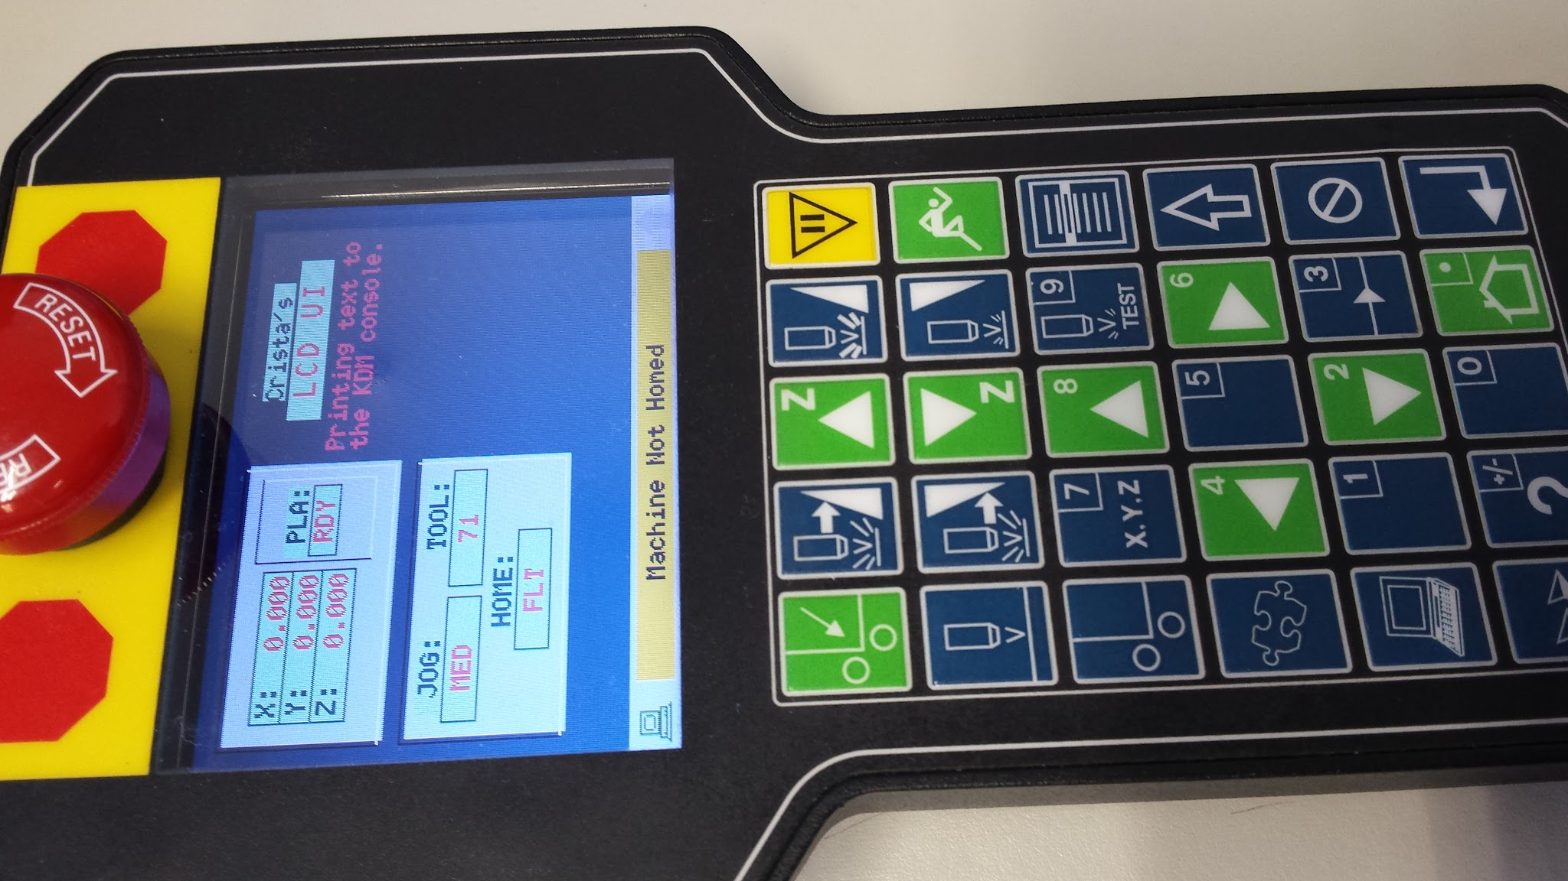
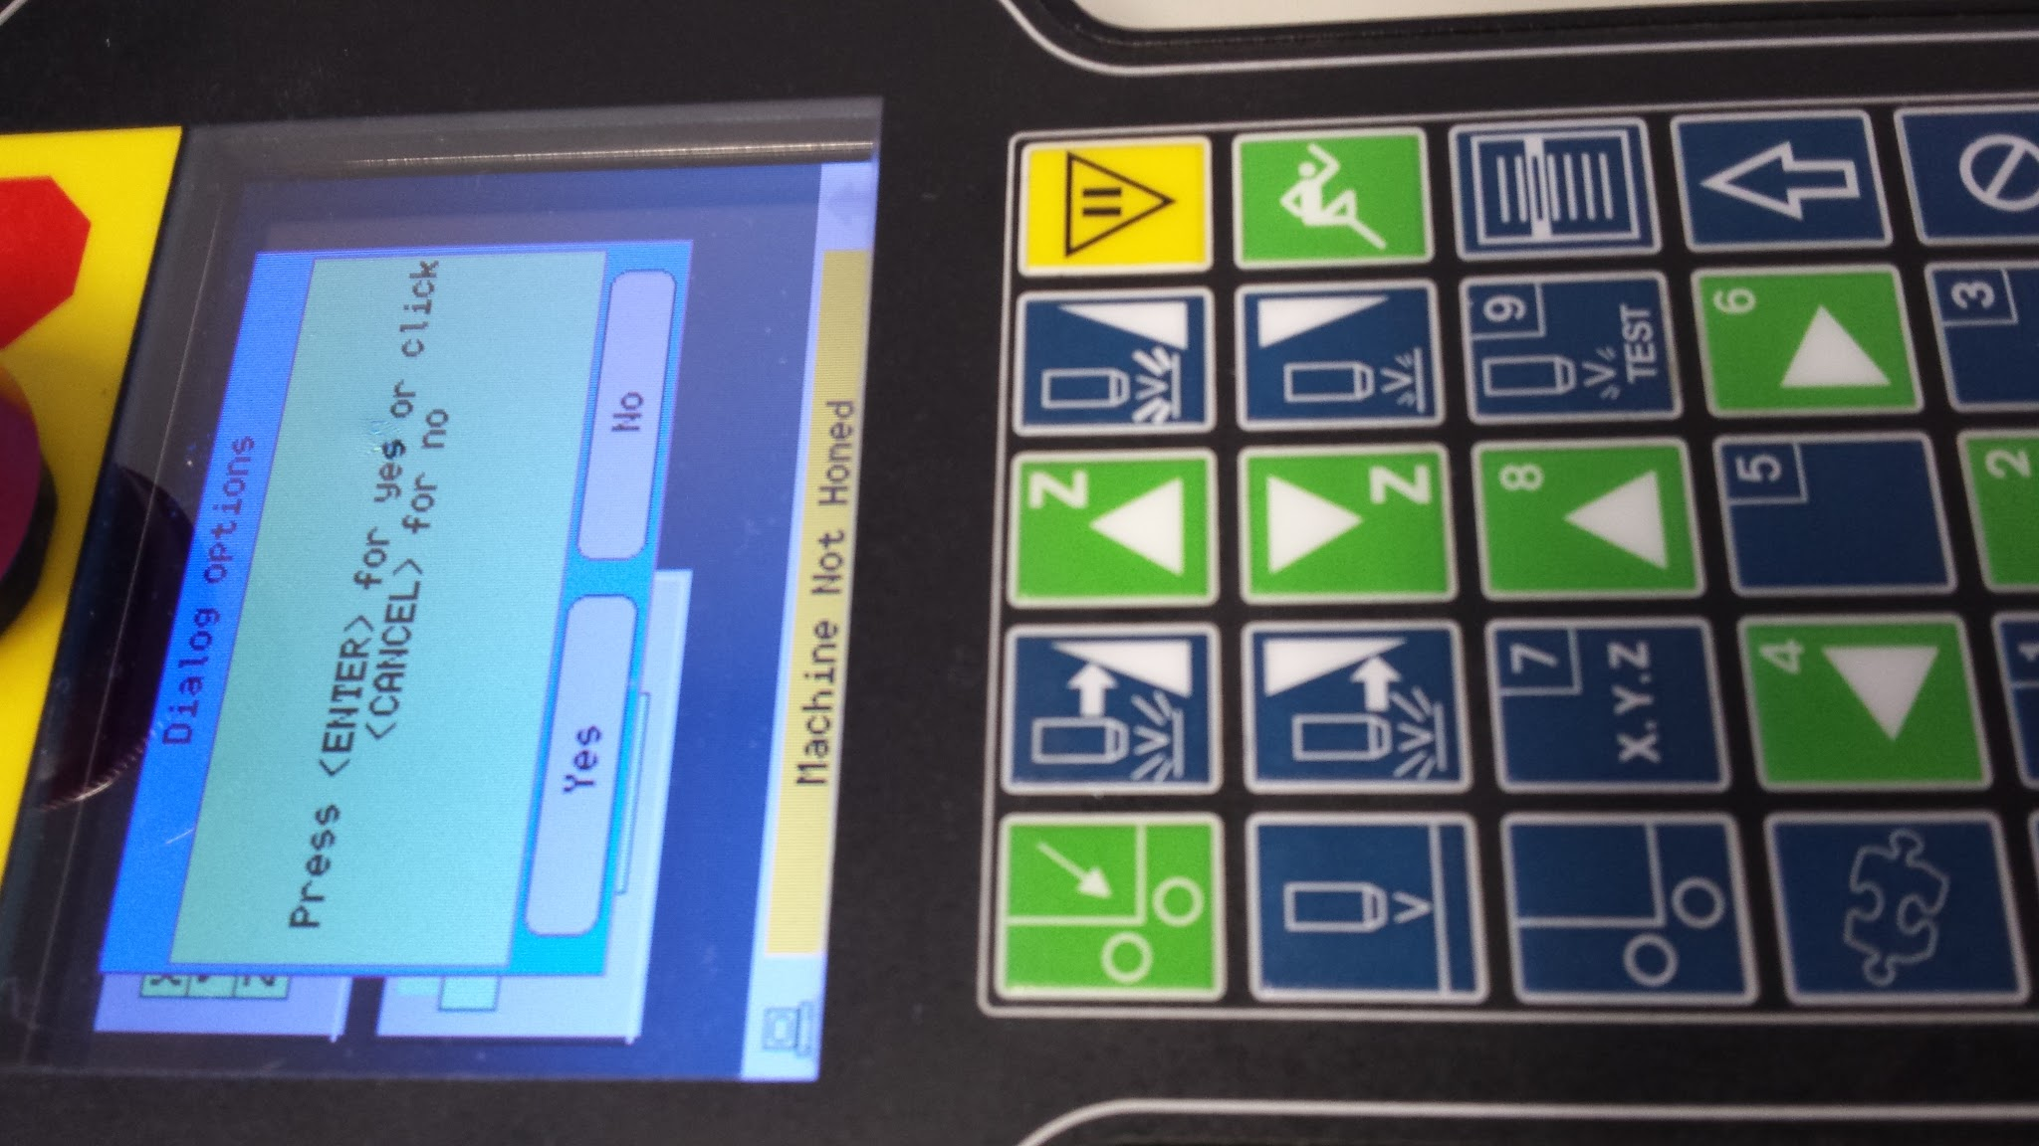
Keypad Controller UI
(my own)

Slide 26
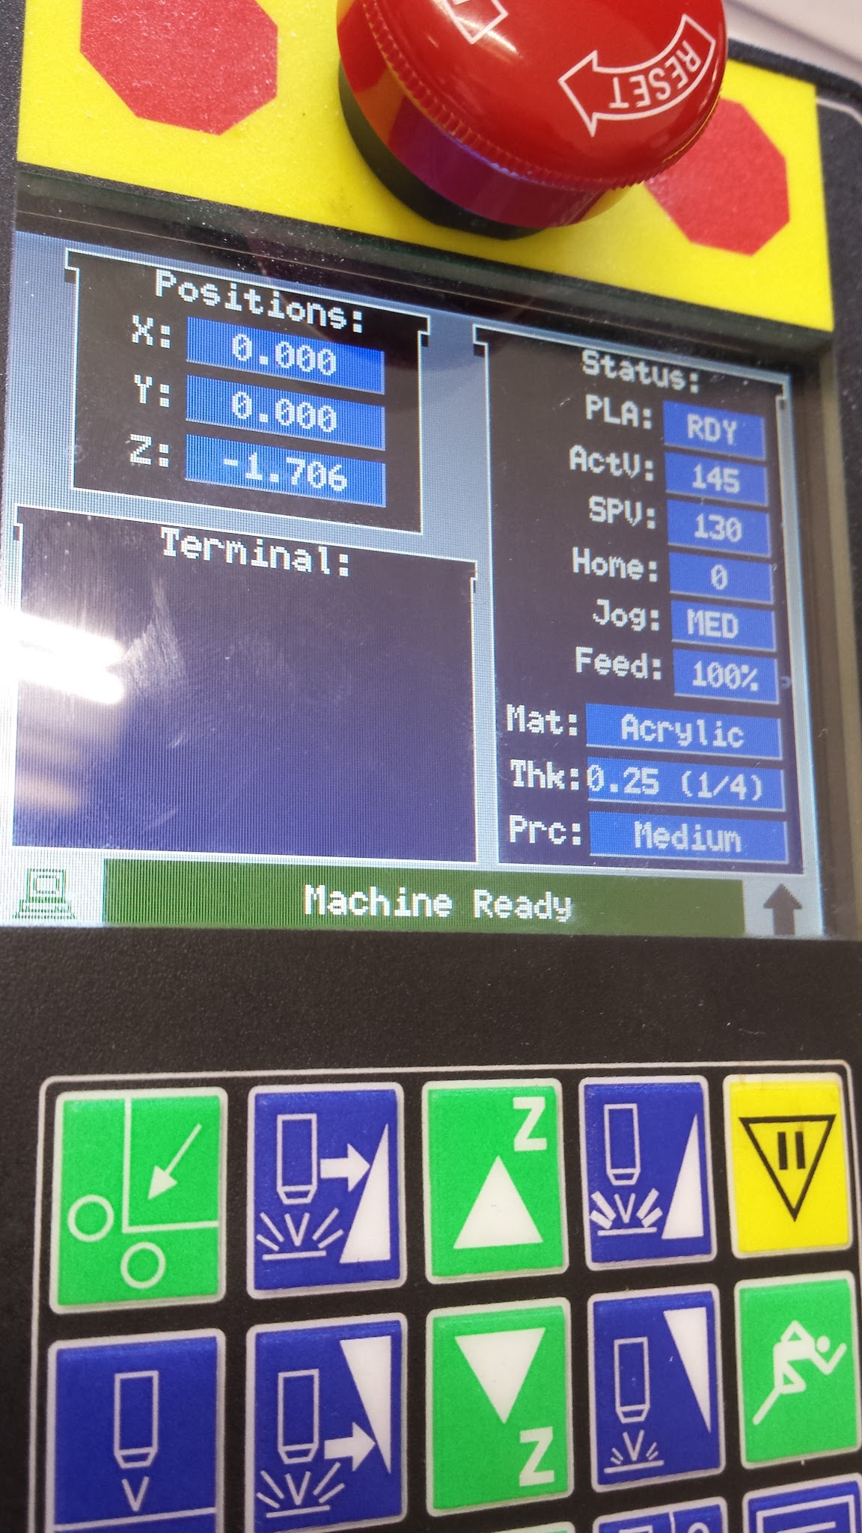
Keypad UI
(for Cincinnati's Predator Controller)

Slide 27
Code Snippet

Slide 28
μCito (Keypad Controller UI)
Keypad UI
: turtle_up "" _________________" 170 170 glcd_text "" _________________" 170 167 glcd_text "" _________________" 170 164 glcd_text "" " 170 152 glcd_text "" _.._ __ " 170 112 glcd_text "" .'\__/'.|^_} " 170 124 glcd_text "" \_/__<__>__] " 170 136 glcd_text "" /_/ \_\ " 170 148 glcd_text ; : turtle_down "" _________________" 170 166 glcd_text "" " 170 112 glcd_text "" " 170 116 glcd_text "" _.._ __ " 170 128 glcd_text "" .'\__/'.|'_} " 170 140 glcd_text "" |_/__<__>__] " 170 152 glcd_text "" \_\ /_/ " 170 164 glcd_text ; : turtle_jump cTEAL cWHITE glcd_text_colors ` 165 90 140 90 222 sunkin_cbox_add drop 270 9 -3 step turtle_down i msd turtle_up i 10 - msd endstep "" _________________" 170 166 glcd_text "" " 170 112 glcd_text "" " 170 116 glcd_text "" " 170 128 glcd_text "" _.._ __ # " 170 140 glcd_text "" .'\__/'.|;-] " 170 152 glcd_text "" __/__<__>__\___ " 170 164 glcd_text ;
:: baseScreen set_small_text cBannerBG dup dup cBannerFG >TextWindowColors 170 50 140 133 0 add_TextWindow kdm_config cBannerBG glcd_fg cBannerSF glcd_bg 10 10 150 80 101 sunkin_cbox_add drop 10 100 150 80 102 sunkin_cbox_add drop ` 10 10 150 200 glcd_box ` 105 20 110 80 glcd_line 107 20 47 60 103 sunkin_cbox_add drop set_small_gtext cBannerSF cBannerBG glcd_text_colors 23 25 1 xpos_widget drop "" X:" 27 27 glcd_text 23 40 1 ypos_widget drop "" Y:" 27 42 glcd_text CORE.NUM_Z_AXES if 23 55 1 zpos_widget drop "" Z:" 27 57 glcd_text endif cTRANSPARENT cTEAL glcd_text_colors ` 60 18 >widget_size "" JOG:" 25 107 glcd_text 20 120 1 jspd_widget drop ` [<index#>] <x> <y> <mode=1> jspd_widget "" TOOL:" 110 107 glcd_text 90 120 1 tool_widget drop "" HOME:" 25 142 glcd_text 20 155 1 home_widget drop "" DRIVE:" 100 142 glcd_text 90 155 1 dena_widget drop ;
: dialog_with_btns "" Yes" "" No" "" Press <ENTER> for yes or click <CANCEL> for no" "" Dialog options" dlg_2button loop kdm_getkey dup 12 = if drop "" You selected YES" "" GO" dlg_textbox 800 msd DestroyDialog break endif dup 13 = if drop "" You selected NO" "" CANCEL" dlg_textbox 800 msd DestroyDialog break endif drop repeat DestroyDialog reset_kdm ;
: bannerScreenModule baseScreen [ ?PLASMA ] #ifdef ` 100 176 1 third_widget 187 29 1 widget
"" PLA:" 110 34 glcd_text 110 47 1 plasmaEna_widget cBannerSF cBannerSF cBannerSF cRED 0xF000 glcd_control_colors drop cTRANSPARENT cWHITE glcd_text_colors "" Crista's " 205 17 glcd_text ` 202 172 1 test_widget cBannerSF cBannerSF cBannerSF cRED 0xF000 glcd_control_colors drop create_widgets_module #endif ifexists bannerScreen_module bannerScreen_module ; ' bannerScreenModule == bannerScreenModule_ptr

Slide 29
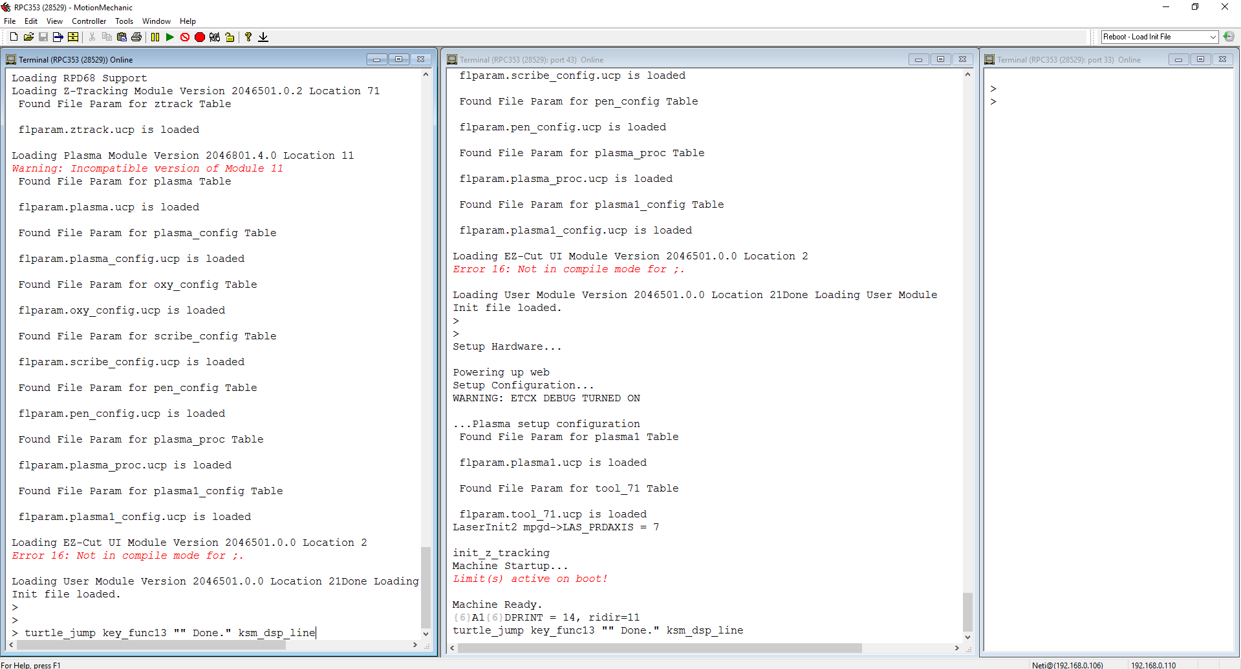
Motion Mechanic (command line)

Slide 30
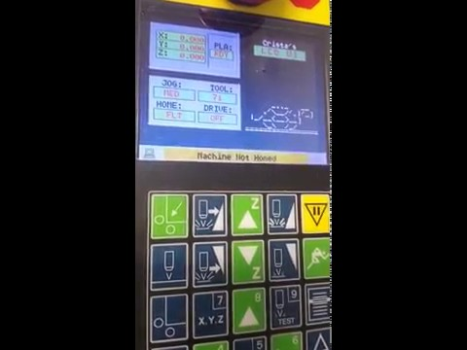
Keypad UI

Slide 31
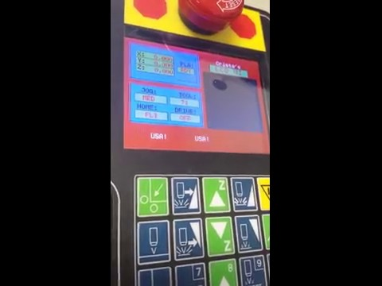
μCito (Keypad Controller UI Cont.)
Keypad UI
: america cWHITE cLGRAY cGRAY cWHITE set_sunkin_effect_colors 0 30 320 35 3 sunkin_cbox_add drop 0 60 320 35 3 sunkin_cbox_add drop 0 120 320 35 3 sunkin_cbox_add drop 0 180 320 35 3 sunkin_cbox_add drop 0 240 320 30 3 sunkin_cbox_add drop cRED cLRED cMAROON cRED set_sunkin_effect_colors 0 0 320 35 5 sunkin_cbox_add drop 0 90 320 35 5 sunkin_cbox_add drop 0 150 320 35 5 sunkin_cbox_add drop ` 0 210 320 30 5 sunkin_cbox_add drop cBLUE cLBLUE cTEAL cBLUE set_sunkin_effect_colors 0 0 180 120 4 sunkin_cbox_add drop 1000 msd cRED glcd_clear_display 10 msd baseScreen bannerScreenModule "" USA! " 50 200 glcd_text 1000 msd "" USA! " 140 200 glcd_text 1000 msd "" USA! " 230 200 glcd_text ;

Slide 32
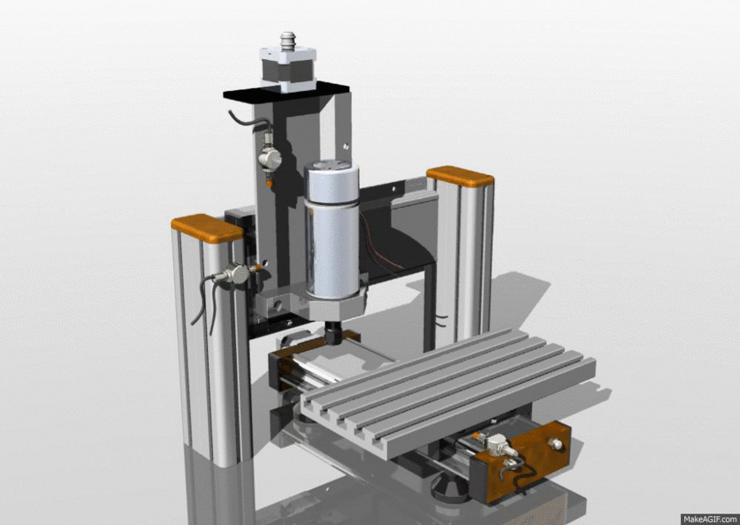
uCito Job Commands

Slide 33
Code Snippet

Slide 34
μCito (Machine Movement)
Buffered Commands
: move_axes_individually laxisx get_pos? ivar start_x laxisy get_pos? ivar start_y laxisz get_pos? ivar start_z start_motion 5. 0 axis_uline 1000 delay start_x 0 axis_umaline 5. 1 axis_uline 1000 delay start_y 1 axis_umaline .5 2 axis_uline 1000 delay start_z 2 axis_umaline fp end_motion ; : two_dim_arc start_motion 8. 8. laxisz get_pos? 2. 0. 120. 0. 0. arc3 fp end_motion ; : frog_slew_curve start_motion get_soft_home? umaline fp 0.2 set_frogslew_factor 3. 4. laxisz get_coord? frog_slew 500 delay 0.1 set_frogslew_factor 5. 6. laxisz get_coord? frog_slew 500 delay 0.5 set_frogslew_factor 0. 0. laxisz get_coord? frog_slew fp end_motion ;
: line start_motion 5. 5. 0. 0. 0. 0. 0. 0. umaline fp end_motion ` Absolute positioning ; : line_back start_motion get_soft_home? umaline fp end_motion ` Relative coordinates ; : three_dim_arc start_motion 5. 5. laxisz get_pos? 3. 30. 150. 10. 180. arc3 fp end_motion ; : go_home start_motion 0. 0. 0. 0. 0. 0. 0. 0. umaline fp end_motion ; : bezier_curve start_motion laxisx get_pos? laxisy get_pos? fover fover 0. 5. 10. 0. 6 fpluck 6 fpluck bz2 fp end_motion ; : arc_helix start_motion 2. 2. -0.2 1. 20. 240. 2 -0.2 ahelic fp end_motion ;

Slide 35
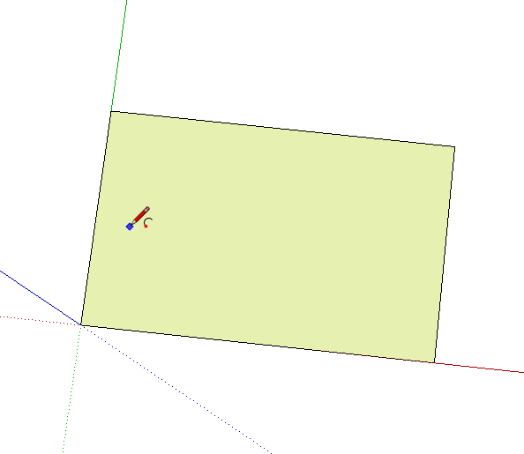
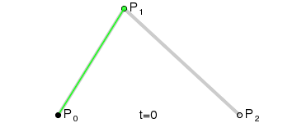
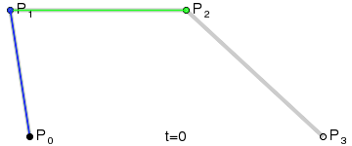
Job Commands
Bezier Curves
<x start> <y start> <x c1> <y c1> <x c2> <y c2> <x stop> <y stop> BZ2
<x start> <y start> <z start> <x c1> <y c1> <z c1> <x c2> <y c2> <z c2> <x stop> <y stop> <z stop> BZ3

Slide 36
Future Plans

Slide 37



Education:
Massachusetts Institute of Technology
Stanford University
Carnegie Mellon University
UCLA
Major:
B.S. in Computer Science
Potentially dual-major in another physical science (e.g. chemistry, physics)
Career:
Software Engineering

Slide 38

Questions?

Slide 39
THANK YOU!

